Slide 1
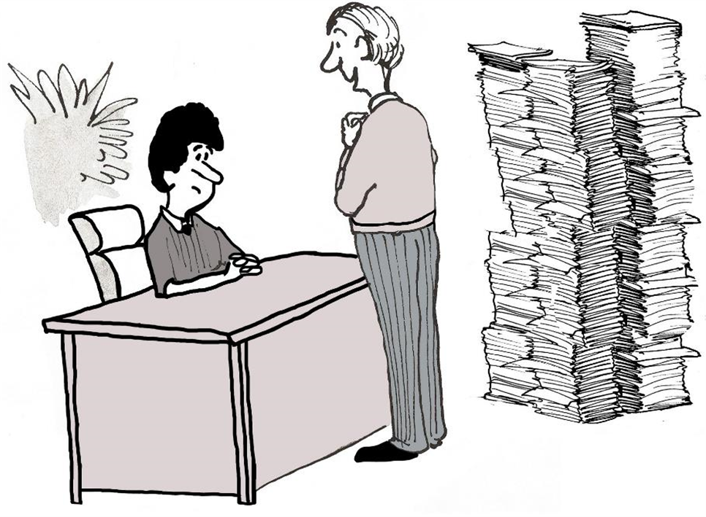





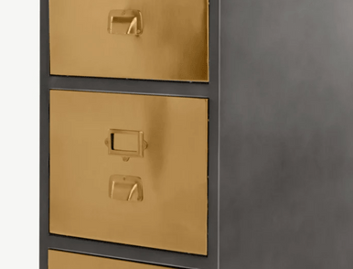

Data Retention Workshop
Stuart Lee
DPE consultant and workshop presenter

Slide 2




Agenda
Introductions
Data retention - your responsibilities and opportunities
Schedules and tools available to you
Physical and electronic data
Data and data systems in your organisation (third party systems)
>

Slide 3

Data Protection Principles
Lawfulness, fairness and transparency
Purpose limitation
Data minimisation
Accuracy
Storage limitation
Integrity and confidentiality (security)
Accountability
>

Slide 4


Organisational responsibilities
Organisations can set deadlines, document and justify timeframes they have set for retaining data.
>
There are two key factors: the purpose for processing the data, and any legal or regulatory requirements for retaining it.
To limit the damage and harm from a data breach, regulators mandated that organisations must retain personal data only if there’s a legitimate reason for keeping it.

Slide 5

Why is data retention good practice important?
Only keep for as long as needed - reduces the risk of a data breach
Laws and Regs
Business improvement
Refined processes
Free up space - both physical and electronic
UK GDPR
Education Act
Keeping Children Safe in Education
Do you know your responsibilities?
Damage limitation
>

Slide 6

What can go wrong?
We dont need to worry!
>
Are you confident that there is no outdated personal information in your organisation?
>

Slide 7
Does anyone ever get fined?
>
Berlin Commissioner for Data Protection Imposes Fine on Real Estate Company (14.5 million Euros)
Fines do happen!
>
Notes:
https://edpb.europa.eu/news/national-news/2019/berlin-commissioner-data-protection-imposes-fine-real-estate-company_en

Slide 8
Use supporting tools and documents…..
Microsoft retention tools
Google retention tools
MIS retention tools
Network scanning and retention tools department
Information Records and Management Service (IRMS)
Gov.uk guidance - data retention toolkit for schools and annual review of school data checklist
DPE’s data retention and record management best practice area and records management policy
DPE’s Record of Processing (RoP)
Privacy notice - third party/supplier list
Laws and regulations (for example, financial regulations and handbooks and limitations act: https://www.legislation.gov.uk/ukpga/1980/58 /legislation: https://www.legislation.gov.uk/uksi/2021/833/contents/made )
>
Lets take a closer look

Slide 9
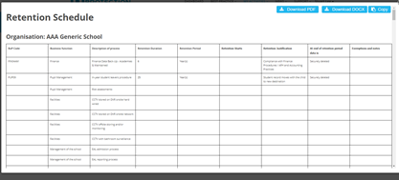
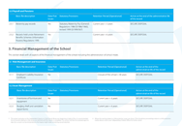
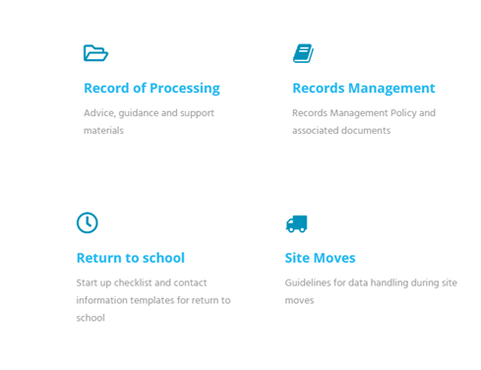
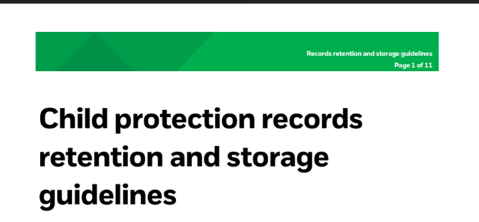
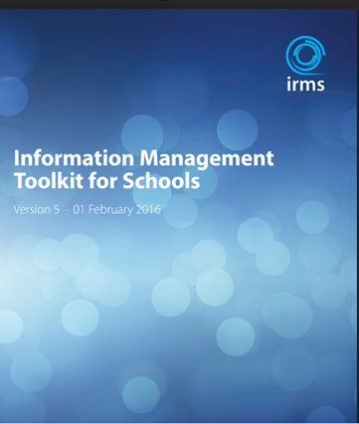
Use supporting tools and documents with your plan…

Slide 10
Identifying where school data is held and different systems....
Website
Physical documents
CLOUD
Network
Local devices
MIS
Google/Microsoft
Ed Apps i.e. Tapestry
HR/Finance
Emails
>
It was never going to be easy!

Slide 11
Identify what data is held on different systems
Names
Contact details
Attendance
Assessment
SEND
PP
Phyiscal data
MIS/CLOUD
Staff names
Student names
Contacts
Financial
Employment
Contracts/HR
SEND
PP
Assessment
Safeguarding
Medical
Behaviour
Names
Photos
Contact details
Attendance
Employment
Contracts/HR
Census
Assessment
SEND
PP
Behaviour
Do you know what data is held on your systems and how old that data is?
>
Ed tech

Slide 12
Develop data retention policies and schedules
Your data retention policy/schedule should explain how long you need to keep information. It should set out:
why you’re holding this data
your justification for keeping the data
the lawful basis for processing and keeping the data
if you’ll pass this data on and, if so, once you’ve passed it on, if you need to keep it
the steps you’ll take when you destroy any personal data
>
It was never going to be easy!

Slide 13
Develop data retention policies and schedules
When setting a data retention policy/schedule, consider:
why you’re holding this data
if there’s a legal duty to keep the information for a set period of time
whether you’ll need to share the data and, if so, whether you need to keep it after sharing it
if it’s more appropriate for another organisation such as the local authority to keep the information in the long term
if you’ll need the data to meet Ofsted’s requirements
whether you can delete or depersonalise some of the information
if you have a justification to keep the data
>
It was never going to be easy!

Slide 14
Where do we start?
Create a data map to identify where data resides
Complete a data audit - paper records and electronic
Break it down by system and then what data (categorise the data by sensitivity) is held in each system
Develop your retention schedule and record management (including the legal and regulatory environment)
Develop systems and routines for periodic data cleansing (disposing) of different data i.e. website
Raise staff awareness and support - encourage staff to routinely check through electronic folders - especially information relating to leavers
>
It was never going to be easy!

Slide 15
Have a PLAN to work from
>
Data Retention
Check with your MIS provider regarding what support they can offer and tools available to support you with data retention
Ascertain what data is currently residing in your MIS
Look at historical MIS data - how far does the data go back?
Management Information Systems (MIS) - example of possible steps to take….
Use your retention schedule to identify data that can be deleted/anonymised and document/rag rate this prior.
For leavers - check if your MIS allows for archiving with restricted access. By restricting access you reduce risks!
Be careful! Different legislation may apply to different data sets i.e. attendance registers should be kept for 3 years from the time of entry (leavers?) was made (DfE school attendance data guidance 2021-22). What about home educators - who is responsible?
Check with your LA as to attendance/admission records i.e. does the LA maintain a record of students start and end date? This is needed for example, if an ex-student/prospective employee wanted to know start and end dates, or if there was a legal process taking place. If the LA does not keep this information, you may be justified in keeping some information (in an archive).
Once all the above has been checked, start the process of sifting through the data by category.
Run bulk deletion routines starting with the data held the longest (you may need to protect certain records/data from bulk deletion). Get confirmation and authorisation from senior staff prior to any bulk deletion and recheck as necessary (retention schedule).
Run routines to delete historical documents and contacts
Document and maintain a record of data that has been permanently deleted/anonymised and reference to your retention schedule

Slide 16
Always check with your IT provider initially to identify if retention can be set at a global level. More information can be obtained here regarding using the admin functions in Google. You can also apply filters in advanced settings to auto delete emails meeting certain criteria. In addition, check your schools email retention guidelines before completing any bulk deletion routines. Ensure any email transcripts and attachments that need to be saved, are saved to an appropriate electronic location prior to completing any deletion routines.
Data retention and practical steps to managing emails in Gmail
>
Let's now look at how you can set a date range inline with your data retention policy for Gmail and quickly manage retention periods in Gmail…..

Slide 17
How to manually apply filters to delete gmail emails after a set period of time:
The following details how you can easily manually apply retention to your Gmail to filter and delete old emails in bulk. A retention period of 1 year is used in this example although this period can be changed in accordance with your retention policy:
Log in to your google Gmail account.
Enter the following search query in the search bar: older_than:1y (this can be adjusted by replacing 1y with any time period you want i.e 2y):
On your keyboard, hit: Enter.
Then select the checkbox so all messages are selected for deletion:
Select all conversations that match this search (this will delete all messages within the date specified rather than those selected for that page). You can also apply other filters if for example, you want to delete specific messages from a specific email address or subject etc.
Click and select the Trash bin icon:
Note: deleted messages will sit in your bin that is displayed below your inbox for 30 days and are automatically deleted after this. If you wanted to delete from there you can manually do this by selecting the bin and selecting: delete forever.

Slide 18
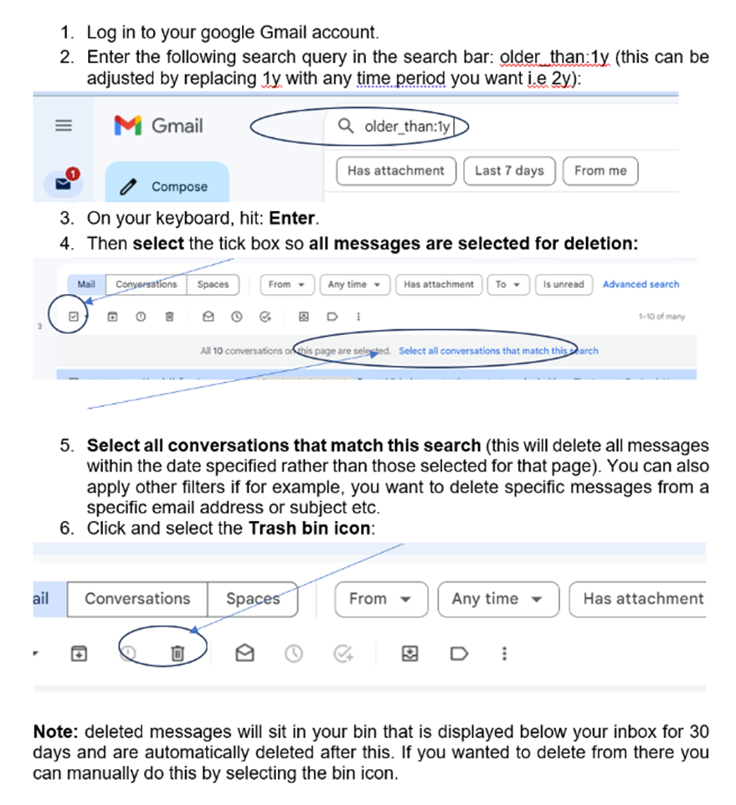
Let’s take a closer look………………

Slide 19
Recap on the main points..
Develop a plan and allow time to complete your retention schedule…
Complete a personal data audit, including identifying and documenting software:
Identify and document where data is currently residing and how far this data goes back
Use your retention schedule as a live document to maintain data on systems and keep up to date
Regular review and maintain!
DPE is here to support you
>
Managing data retention is a continuous process
>
Notes:
Focus areas:
Poll:
Is cyber risk on your organisation's risk register?
Yes
No
Not sure

Slide 20
Contacts
Thanks for attending!
Phone
0800 0862018
Website
https://dataprotection.education
Email
dpo@dataprotection.education

Slide 21

Questions...

Slide 22


THANK YOU
See You Next Time

